Slide 1



HEALTH INSURANCE PREMIUM PREDICTION
SUPERVISED BY:
Ms. Shagun Sharma
SUBMITTED BY:
Kritica (2210990523)
Kritika Bansal (2210990524)
Lavika Singla (2210990540)

Slide 2

INTRODUCTION
Health insurance premiums are a significant expense for individuals and families. Accurately predicting these premiums can help consumers make informed decisions and allow insurance providers to optimize their pricing strategies. This presentation will explore the use of machine learning techniques to forecast health insurance premiums based on various demographic and health-related factors.

Slide 3
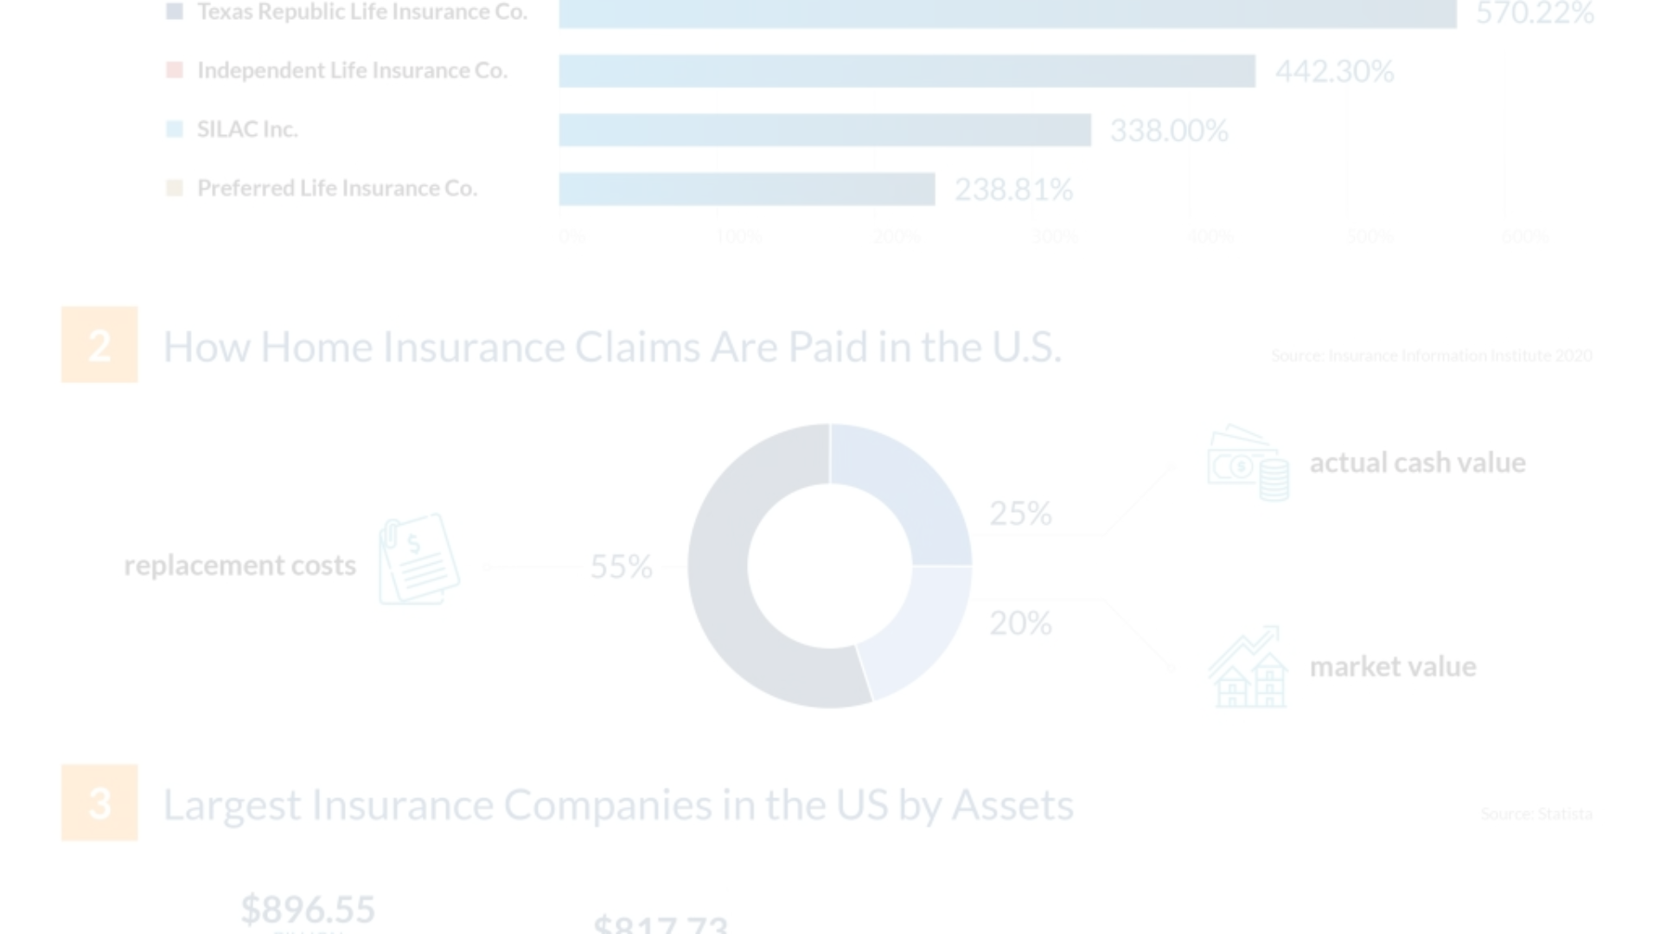

OBJECTIVE
To develop a predictive model that accurately forecasts health insurance premiums for individuals or groups based on their demographic information, medical history, lifestyle factors, and healthcare utilization patterns, ultimately enabling insurance providers to optimize pricing strategies, improve risk management, and enhance transparency in the healthcare market.

Slide 4
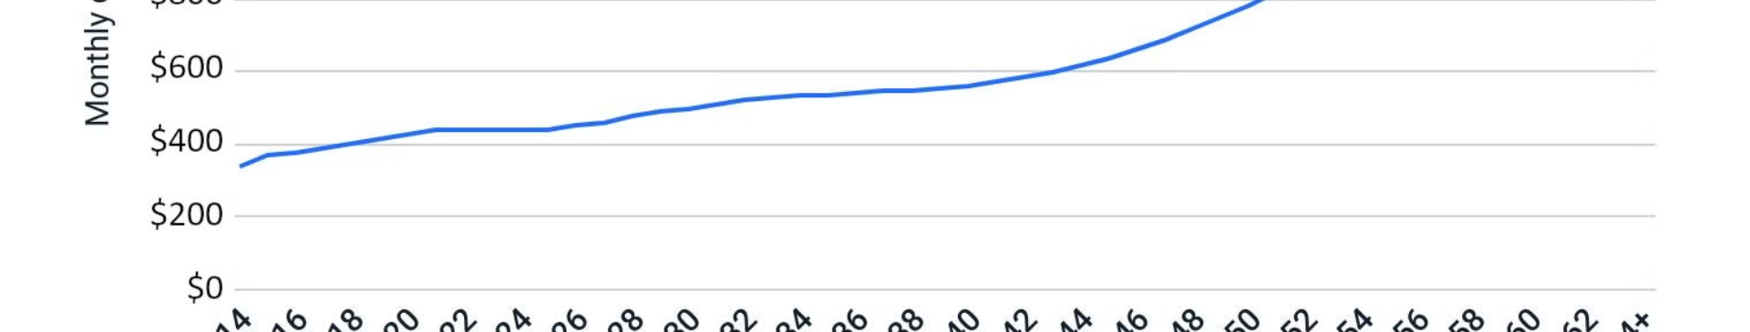
PROBLEM STATEMENT
The problem we aim to address is the unpredictability and lack of transparency in medical insurance premium determination. Currently, insurance companies face challenges in accurately assessing insurance premiums, leading to disparities in pricing and potential financial risks for both insurers and policyholders.

Slide 5
SOLUTION
The primary goal of this project is to develop a machine learning model that can accurately predict health insurance premiums based on various demographic and health-related factors. This will empower consumers to make informed decisions when selecting health insurance plans and enable insurance providers to optimize their pricing strategies.

Slide 6
SOFTWARE/HARDWARE REQUIREMENTS
Software: Python, Jupyter Notebooks, Numpy, Pandas, Matplotlib/Seaborn, Scikit-Learn,
Streamlit, Pickle
Hardware: A machine with at least 8GB RAM and a multi-core processor
Datasets: Publicly available datasets

Slide 7
DATA REQUIREMENTS
Demographic data: Age, Gender, Region, No. of Children
Health history: BMI
Lifestyle factors: Smoking Status

Slide 8
Proposed Design / Methodology
Data Collection and Preprocessing: Gather historical data on medical insurance premiums along with demographic and lifestyle factors such as age, gender, BMI, number of children, smoking habits, and region. Preprocess the data by handling missing values, encoding categorical variables, and scaling numerical features if necessary.
Exploratory Data Analysis (EDA): Perform exploratory data analysis to gain insights into the distribution of variables, identify correlations between features and the target variable (insurance premiums), and understand any patterns or trends in the data.
Model Training: Split the data into training and testing sets. Train a Random Forest regression model using the training data.

Slide 9
Proposed Design / Methodology
Model Evaluation: Evaluate the trained model using appropriate metrics such as R-squared (coefficient of determination) to assess its predictive performance on unseen data. Conduct cross-validation to ensure the model's robustness and generalization ability.
Prediction and Deployment: Use the trained model to make predictions on new data points. Deploy the model into production either as a standalone application or as part of a larger system where it can be utilized to predict insurance premiums in real-time.
Monitoring and Maintenance: Continuously monitor the model's performance in production and retrain/update it periodically with new data to ensure its accuracy and relevance over time.

Slide 10
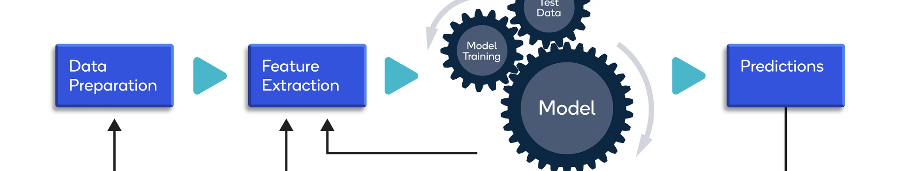
Feature Engineering
To prepare the data for machine learning, we will perform extensive feature engineering. This includes handling missing values, encoding categorical variables, creating new derived features, and scaling numerical attributes. The goal is to transform the raw data into a format that can be effectively leveraged by predictive models.

Slide 11

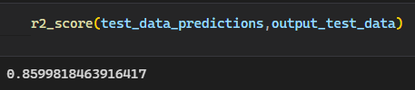
Model Evaluation Metric
R-Squared – It is also known as the coefficient of determination, is a statistical measure that indicates how well the regression predictions approximate the real data points. The range lies between 0 and 1.
The R² value of 0.86 means that the random forest model explains 86% of the variance in the target variable.

Slide 12
CONCLUSION:
Health insurance premium prediction models powered by machine learning offer significant benefits to both insurance providers and consumers. By leveraging advanced algorithms to analyze diverse data points, these models can accurately forecast insurance premiums, enabling providers to better manage risk and set fair pricing while empowering consumers to make informed decisions about their healthcare coverage. As we continue to refine and improve these predictive models, we move closer to a healthcare system that is more efficient, transparent, and accessible for all.

Slide 13
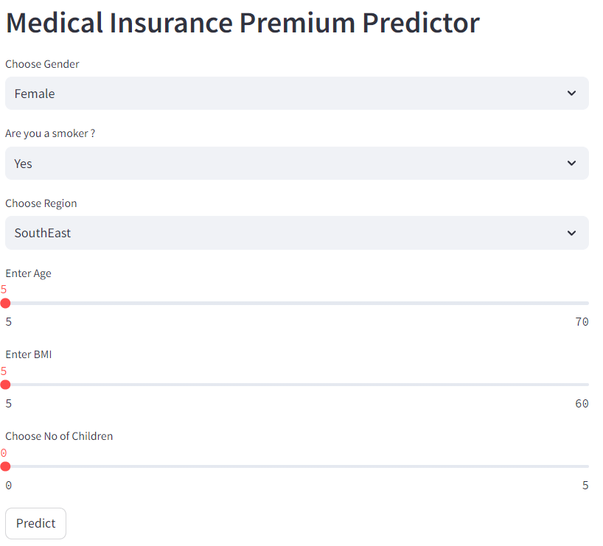
SCREENSHOTS:
Web Interface Of The Project

Slide 14
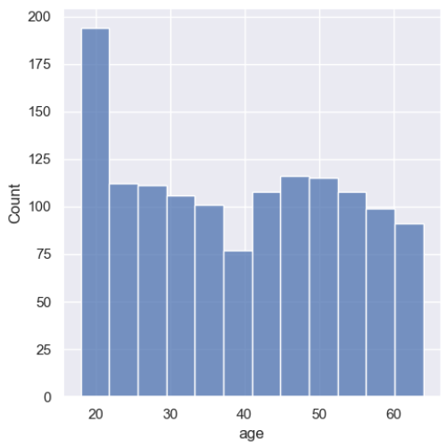
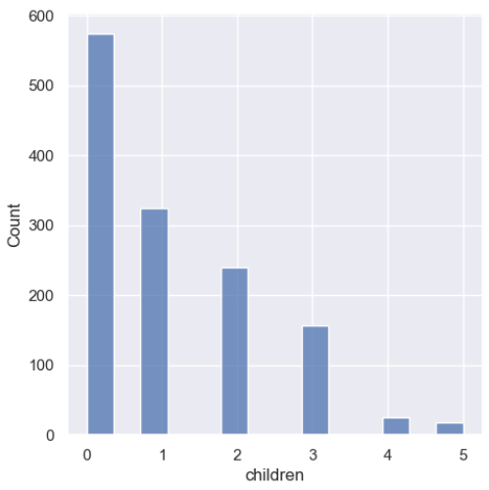
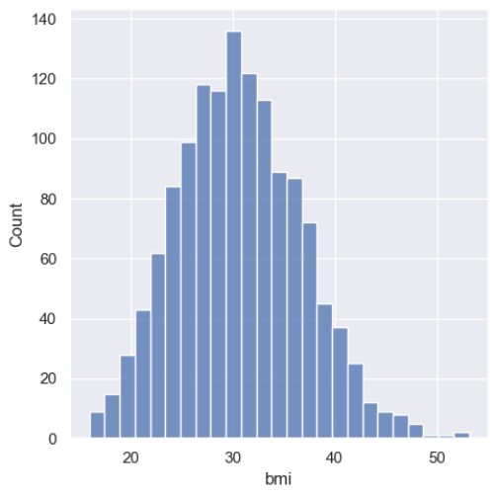
Graphs showing Data Distribution For Numerical Column

Slide 15
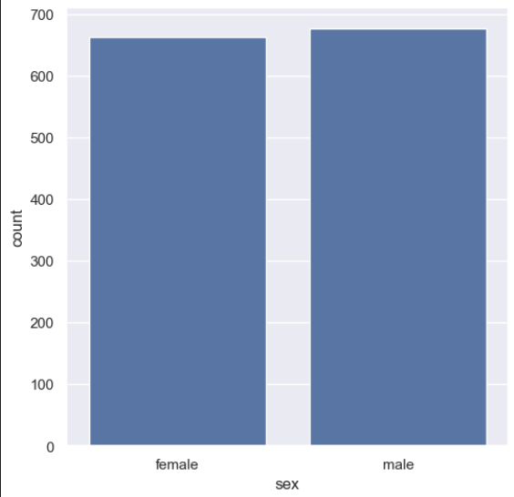
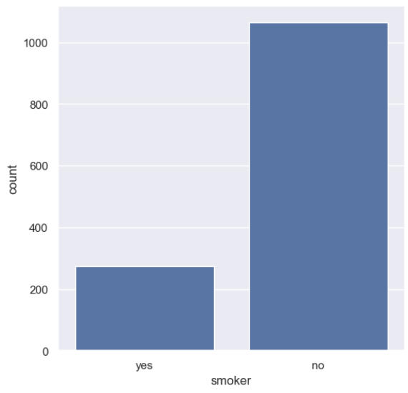
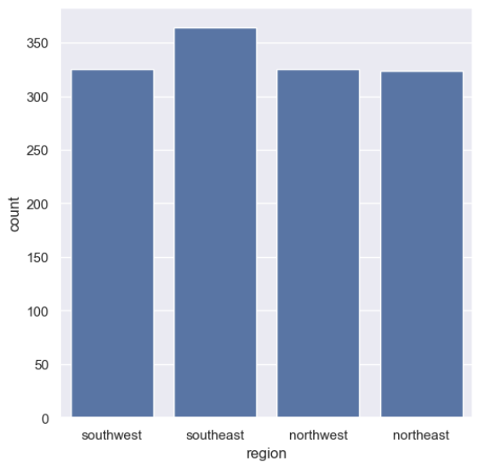
Bar Graphs showing Data Distribution For Numerical Column

Slide 16
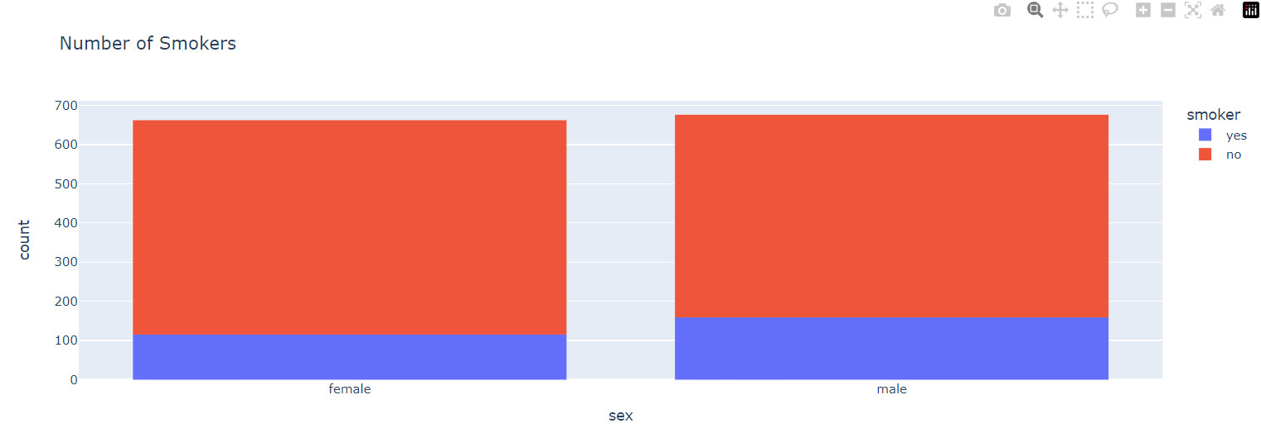

Histogram showing No. Of Smokers
Pie Chart showing No. Of Smokers

Slide 17
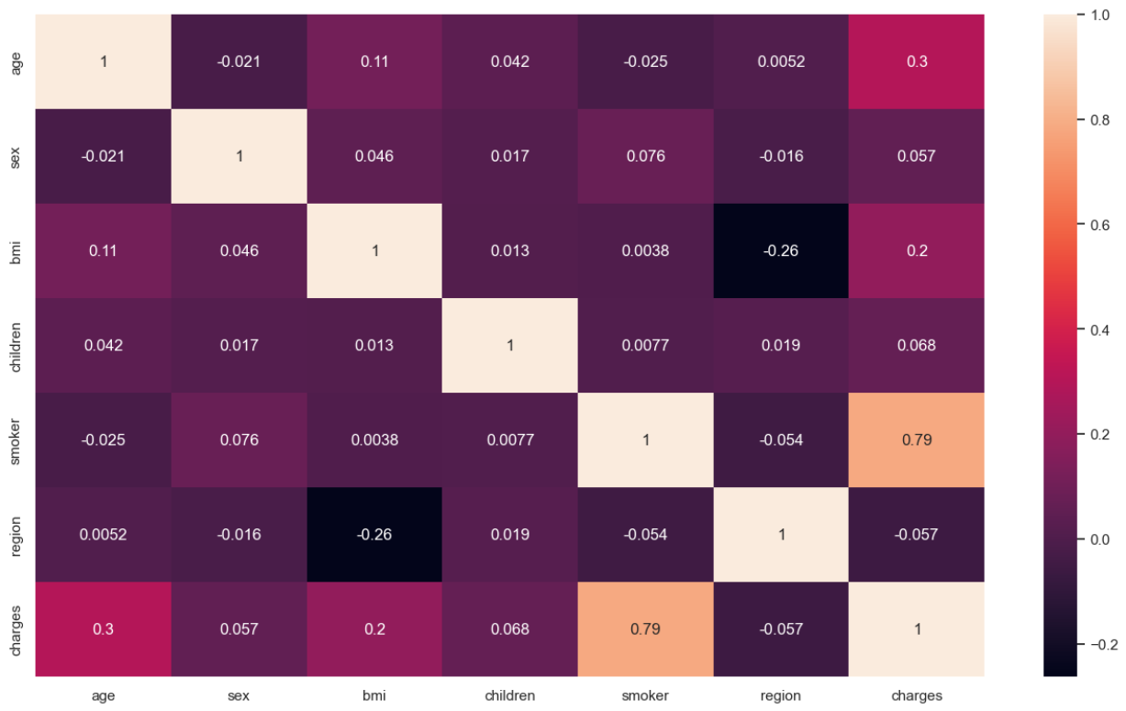
Heatmap Showing Correlation Coefficient between Two Variables

Slide 18
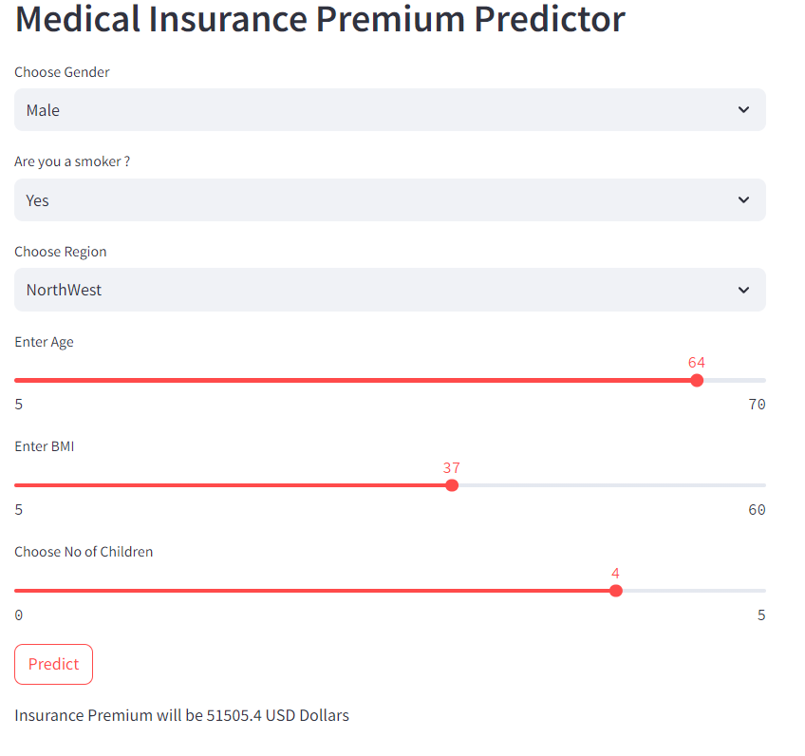
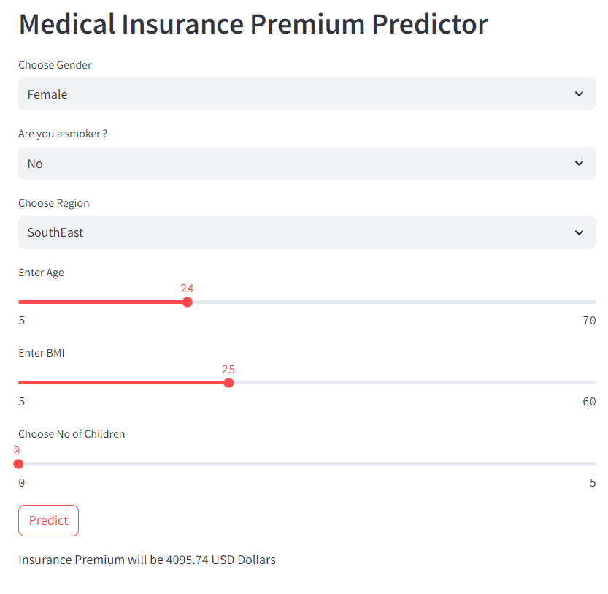
OUTPUT:
Model Predicting The Value According To The User Input

Slide 19
REFERENCES AND LINKS:
https://www.kaggle.com/
https://www.geeksforgeeks.org/
https://www.datacamp.com/
https://www.jmlr.org/
https://www.coursera.org/
https://scholarspace.manoa.hawaii.edu/
https://www.youtube.com/

Slide 20
THANK YOU

